Slide 1
Chapter 7
Higher Order Linear Differential Equations

Slide 2
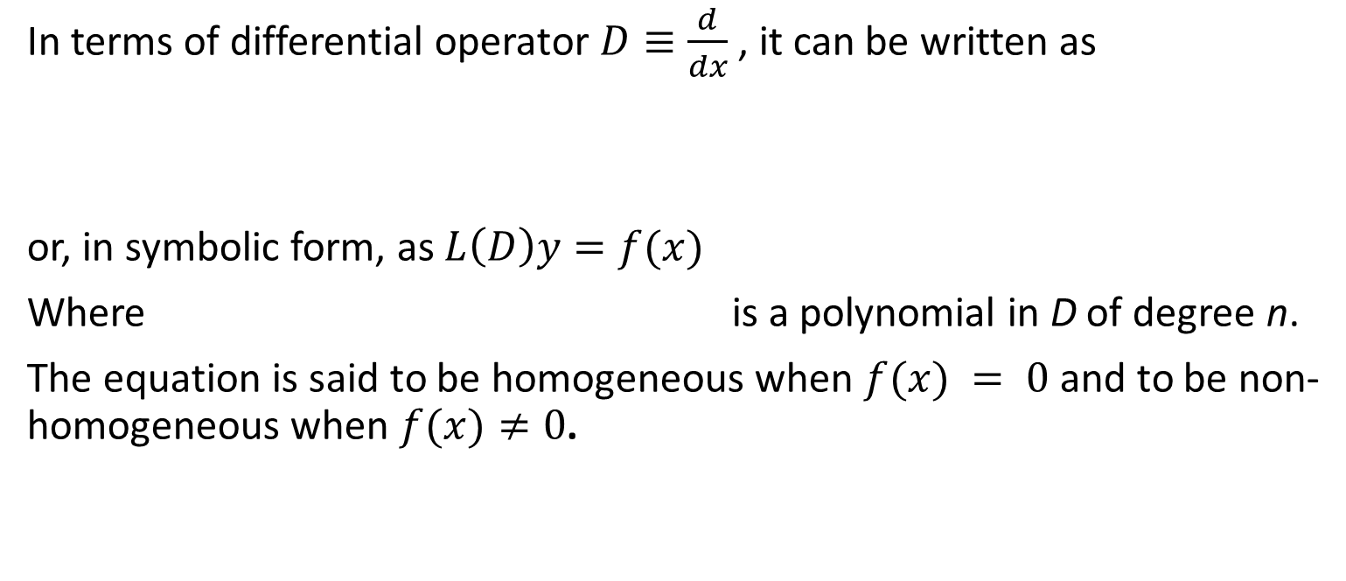
The general nth order linear differential equations with constant coefficients is where are constants.
In terms of differential operator $D≡\frac{d}{dx}$ , it can be written as
or, in symbolic form, as $L\left(D\right)y=f(x)$
Where is a polynomial in D of degree n.
The equation is said to be homogeneous when $f(x) = 0$ and to be non-homogeneous when $f(x)≠0$.

Slide 3
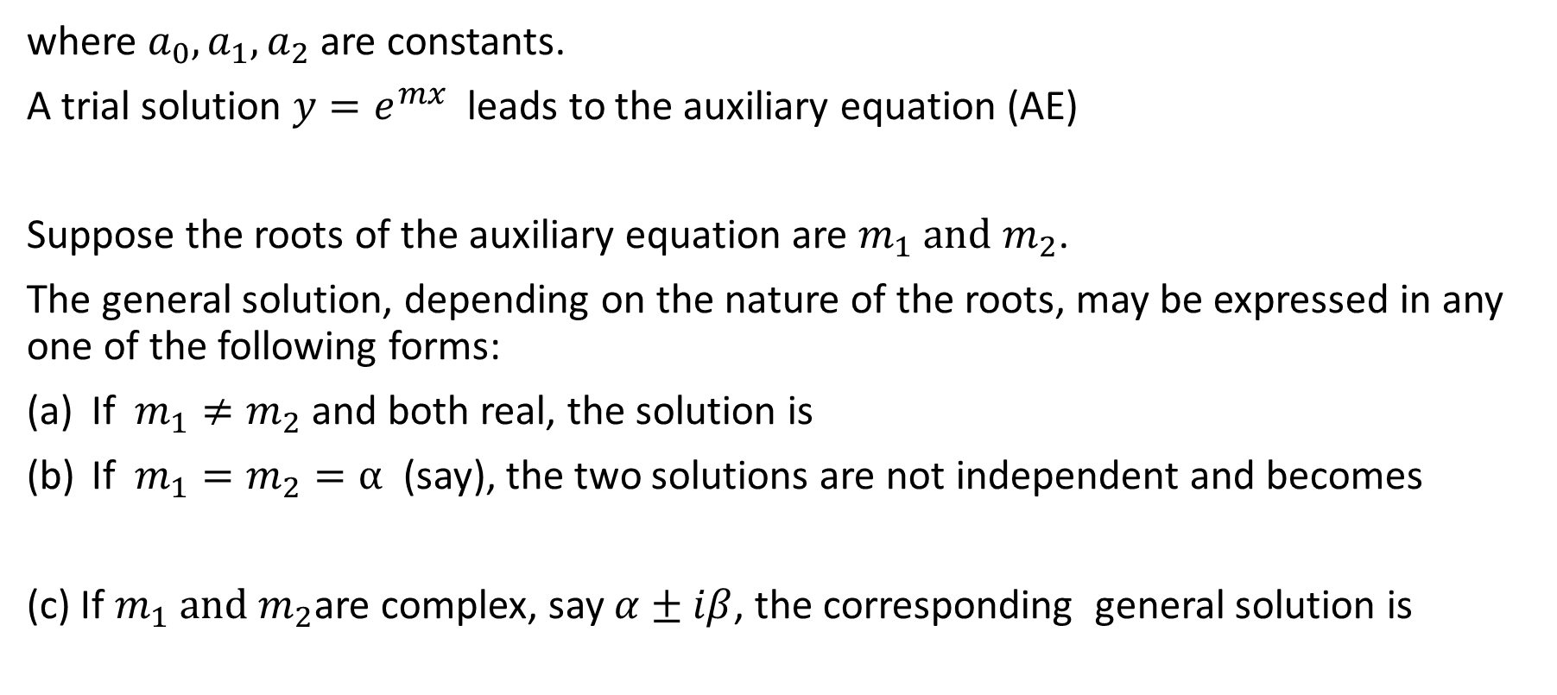
We shall now concentrate on the solution of second order LDEs. The general form of the equation is
where $a_{0}, a_{1}, a_{2}$ are constants.
A trial solution $y=e^{mx}$ leads to the auxiliary equation (AE)
Suppose the roots of the auxiliary equation are $m_{1} and$ $m_{2}$.
The general solution, depending on the nature of the roots, may be expressed in any one of the following forms:
If $m_{1}≠m_{2}$ and both real, the solution is
If $m_{1}=m_{2}=α$ (say), the two solutions are not independent and becomes
(c) If $m_{1} and$ $m_{2}$are complex, say $α±iβ$, the corresponding general solution is

Slide 4
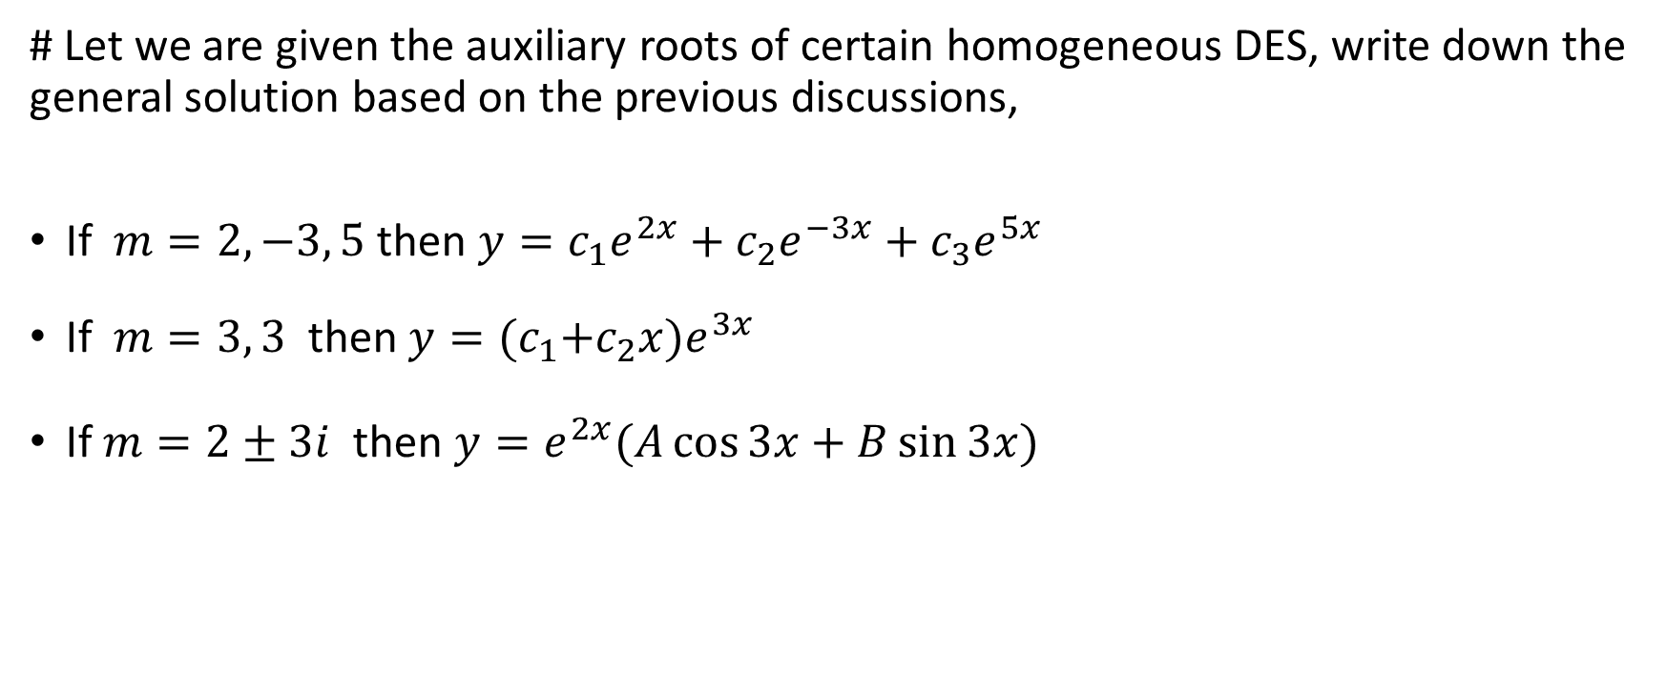
The above rules may be extended for higher order equations.
# Let we are given the auxiliary roots of certain homogeneous DES, write down the general solution based on the previous discussions,
If $m=2, −3, 5$ then $y=c_{1}e^{2x}+c_{2}e^{−3x}+c_{3}e^{5x}$
If $m=3, 3$ then $y={(c}_{1}+c_{2}{x)e}^{3x}$
If $m=2±3i$ then $y=e^{2x}(A\cos{3x}+B\sin{3x})$

Slide 5
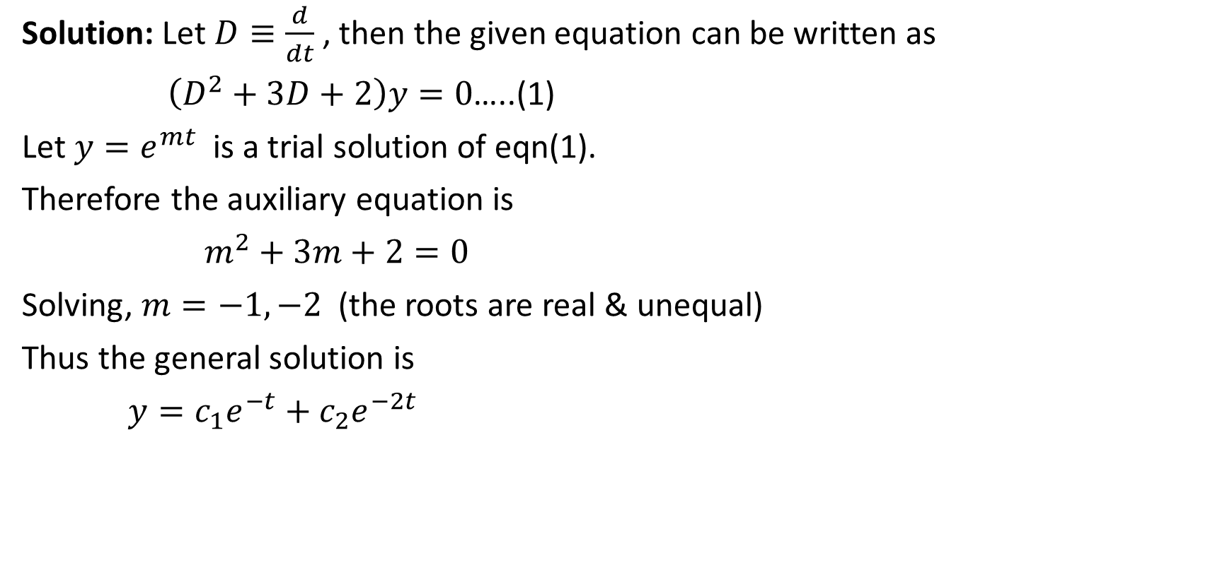
Example 7.1 Find the general solution to $\frac{d^{2}y}{dt^{2}}+3\frac{dy}{dt}+2y=0$.
Solution: Let $D≡\frac{d}{dt}$, then the given equation can be written as
$\left(D^{2}+3D+2\right)y=0$…..(1)
Let $y=e^{mt}$ is a trial solution of eqn(1).
Therefore the auxiliary equation is
$m^{2}+3m+2=0$
Solving, $m=−1,−2$ (the roots are real & unequal)
Thus the general solution is
$y=c_{1}e^{−t}+c_{2}e^{−2t}$

Slide 6
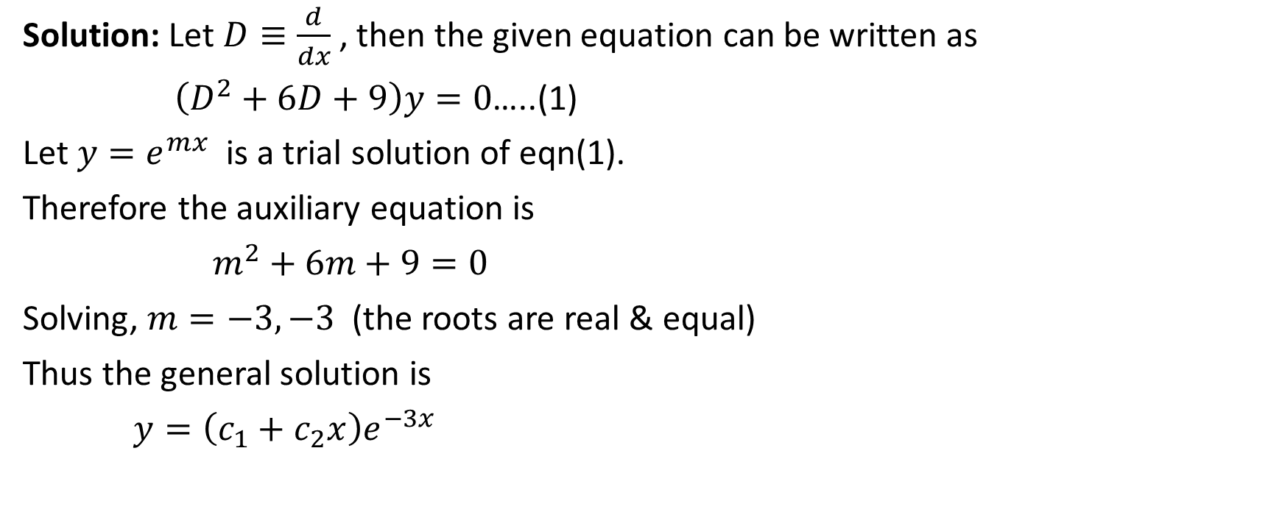
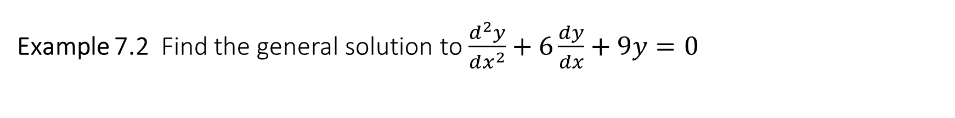
Example 7.2 Find the general solution to $\frac{d^{2}y}{dx^{2}}+6\frac{dy}{dx}+9y=0$
Solution: Let $D≡\frac{d}{dx}$, then the given equation can be written as
$\left(D^{2}+6D+9\right)y=0$…..(1)
Let $y=e^{mx}$ is a trial solution of eqn(1).
Therefore the auxiliary equation is
$m^{2}+6m+9=0$
Solving, $m=−3,−3$ (the roots are real & equal)
Thus the general solution is
$y=\left(c_{1}+c_{2}x\right)e^{−3x}$

Slide 7
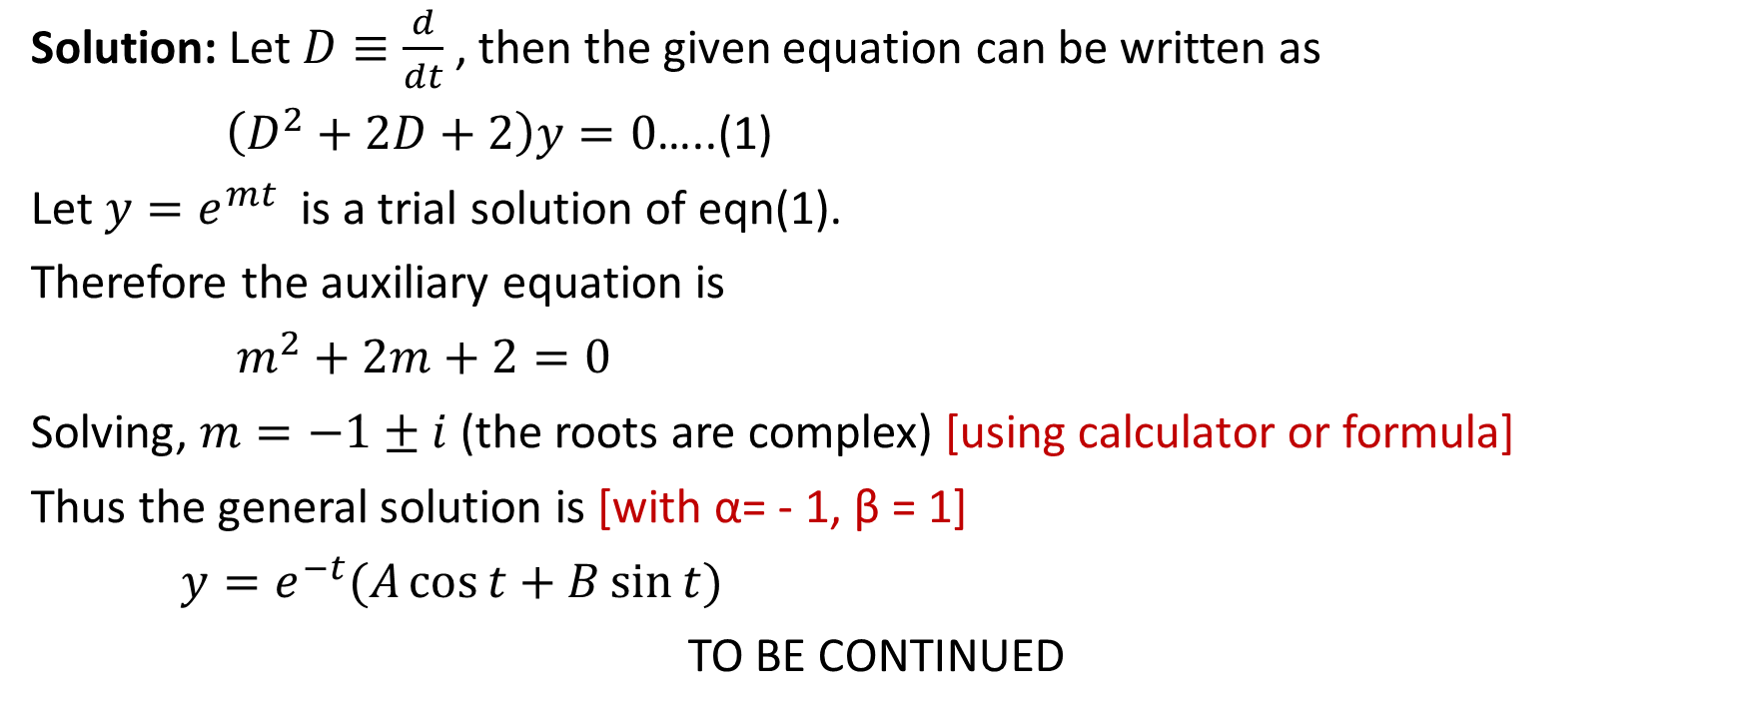
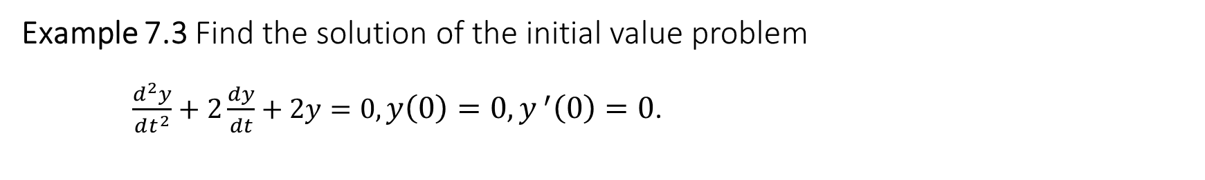
Example 7.3 Find the solution of the initial value problem $\frac{d^{2}y}{dt^{2}}+2\frac{dy}{dt}+2y=0, y\left(0\right)=0, y^{ ′}\left(0\right)=0$.
Solution: Let $D≡\frac{d}{dt}$, then the given equation can be written as
$\left(D^{2}+2D+2\right)y=0$…..(1)
Let $y=e^{mt}$ is a trial solution of eqn(1).
Therefore the auxiliary equation is
$m^{2}+2m+2=0$
Solving, $m=−1±i$ (the roots are complex) [using calculator or formula]
Thus the general solution is [with α= - 1, β = 1]
$y=e^{−t}(A\cos{t}+B\sin{t)}$
TO BE CONTINUED

Slide 8

Now we are going to apply the initial conditions.
$y=e^{−t}(A\cos{t}+B\sin{t)}$……(2)
$y^{ ′ }=−e^{−t}(A\cos{t}+B\sin{t)}+e^{−t}(−A\sin{t}+B\cos{t)}$……(3)
Using $y\left(0\right)=0$, (2) becomes
$$0=1\left(A+0\right)⇒A=0$$
Similarly using $y^{ ′}\left(0\right)=0$, (3) gives
$B=1$
Therefore
$y=e^{−t}\sin{t}$

Slide 9

Class Practice
Find the general solution of the following differential equations:
$\frac{d^{2}y}{dt^{2}}+7\frac{dy}{dt}+10y=0$.
$\frac{d^{2}y}{dt^{2}}+5\frac{dy}{dt}+6y=0$.
$\frac{d^{2}y}{dt^{2}}+4\frac{dy}{dt}+y=0$.
$\frac{d^{2}y}{dt^{2}}+3\frac{dy}{dt}+2y=0, y\left(0\right)=2, y^{ ′}\left(0\right)=−3$.
Home work: P-187: 1-4, 8(b), 8(c),
P-342: 1-8, 11, 12
Differential Equations – P. Blanchard, R. L. Devaney, G. R. Hall (4th edition)

Slide 10
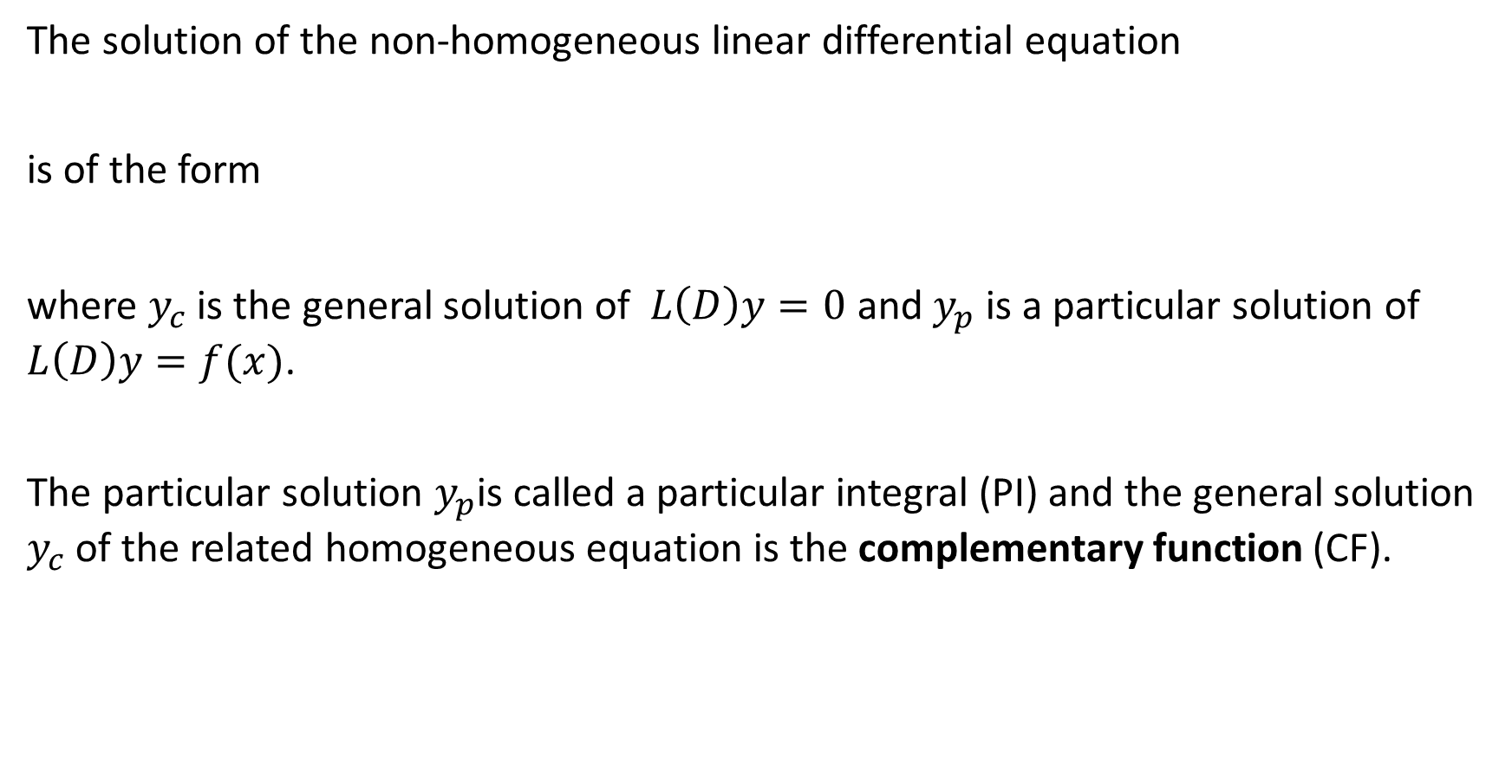
Non-homogeneous LDEs
The solution of the non-homogeneous linear differential equation
is of the form
where $y_{c}$ is the general solution of $L\left(D\right)y=0$ and $y_{p}$ is a particular solution of $L\left(D\right)y=f(x)$.
The particular solution $y_{p}$is called a particular integral (PI) and the general solution $y_{c}$ of the related homogeneous equation is the complementary function (CF).

Slide 11
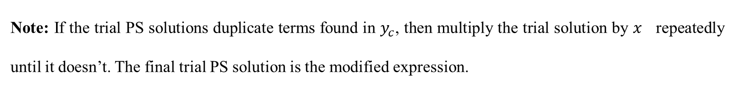
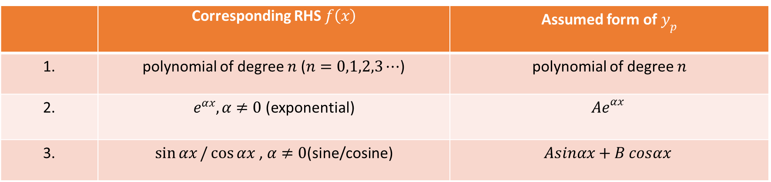
The method of undetermined Coefficient
 | Corresponding RHS $f\left(x\right)$ | Assumed form of $y_{p}$
1. | polynomial of degree $n$ ($n=0,1,2,3⋯$) | polynomial of degree $n$
2. | $e^{αx},α≠0$(exponential) | $${Ae}^{αx}$$
3. | $\sin{αx}/\cos{αx}$ , $α≠0$(sine/cosine) | $$Asinαx+B cosαx$$
Note: If the trial PS solutions duplicate terms found in $y_{c}$, then multiply the trial solution by $x$ repeatedly until it doesn’t. The final trial PS solution is the modified expression.

Slide 12
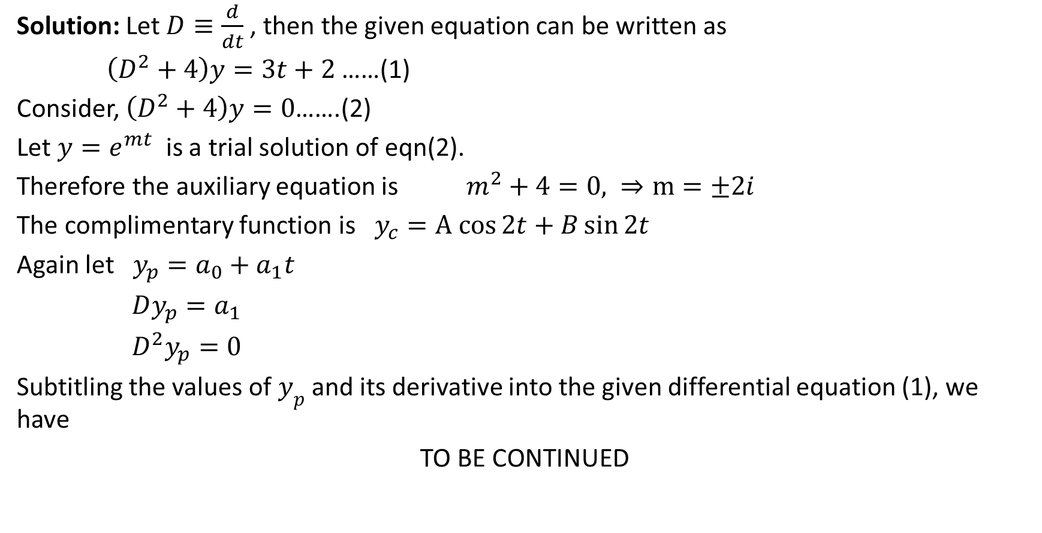
Example 7.4 Find the general solution of $\frac{d^{2}y}{dt^{2}}+4y=3t+2$
Solution: Let $D≡\frac{d}{dt}$, then the given equation can be written as
$\left(D^{2}+4\right)y=3t+2$ ……(1)
Consider, $\left(D^{2}+4\right)y=0$…….(2)
Let $y=e^{mt}$ is a trial solution of eqn(2).
Therefore the auxiliary equation is $m^{2}+4=0, ⇒m=±2i$
The complimentary function is $y_{c}=A cos{2t}+B\sin{2t}$
Again let $y_{p}=a_{0}+a_{1}t$
$Dy_{p}=a_{1}$
$D^{2}y_{p}=0$
Subtitling the values of $y_{p}$ and its derivative into the given differential equation (1), we have
TO BE CONTINUED

Slide 13
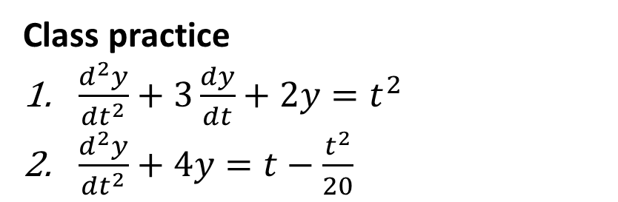

$4 a_{0}+4 a_{1}t=2+3t$
Now, equating like terms, we have,
$4 a_{0}=2$
$4 a_{1}=3$
Solving $a_{0}=\frac{1}{2}$and $a_{1}=\frac{3}{4}$
The general solution is
${y=y}_{c}+y_{p}$
$=A cos{2t}+B\sin{2t}+\frac{1}{2}+\frac{3}{4} t$
CW
Solve $\frac{d^{2}y}{dt^{2}}+6\frac{dy}{dt}+8y=2t$
Class practice
$\frac{d^{2}y}{dt^{2}}+3\frac{dy}{dt}+2y=t^{2}$
$\frac{d^{2}y}{dt^{2}}+4y=t−\frac{t^{2}}{20}$
Home work: P-402: 33-35
Differential Equations – P. Blanchard, R. L. Devaney, G. R. Hall (4th edition)

Slide 14
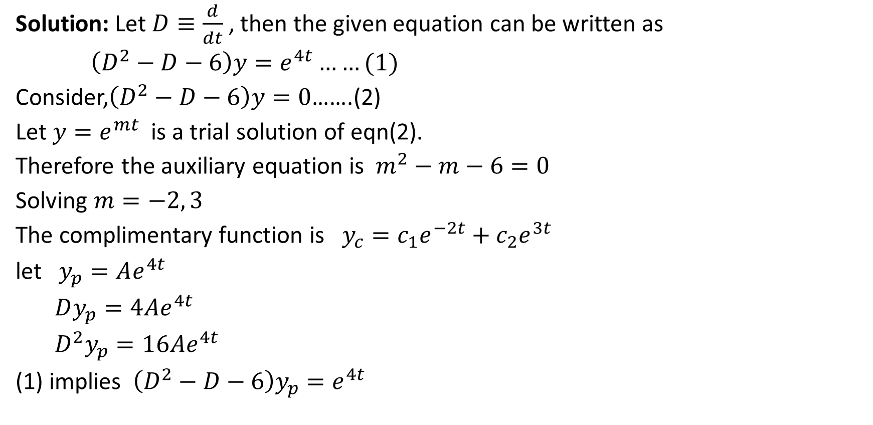
Example 7.5 Find the general solution of $\frac{d^{2}y}{dt^{2}}−\frac{dy}{dt}−6y=e^{4t}$
Solution: Let $D≡\frac{d}{dt}$, then the given equation can be written as
$\left(D^{2}−D−6\right)y=e^{4t}……(1)$
Consider,$\left(D^{2}−D−6\right)y=0$…….(2)
Let $y=e^{mt}$ is a trial solution of eqn(2).
Therefore the auxiliary equation is $m^{2}−m−6=0$
Solving $m=−2, 3$
The complimentary function is $y_{c}=c_{1}e^{−2t}+c_{2}e^{3t}$
let $y_{p}=Ae^{4t}$
$Dy_{p}=4Ae^{4t}$
$D^{2}y_{p}=16Ae^{4t}$
(1) implies $\left(D^{2}−D−6\right)y_{p}=e^{4t}$

Slide 15


$16Ae^{4t}−4Ae^{4t}−6Ae^{4t}=e^{4t}$
$$⇒ 6Ae^{4t}=e^{4t}$$
Comparing $6A=1⇒A=\frac{1}{6}$
Therefore $y=c_{1}e^{−2t}+c_{2}e^{3t}+\frac{1}{6} e^{4t}$
CW
Find the general solution of $\frac{d^{2}y}{dt^{2}}+7\frac{dy}{dt}+12y={3e}^{−t}, y\left(0\right)=2, y^{ ′}\left(0\right)=1$
Class Practice
$\frac{d^{2}y}{dt^{2}}+6\frac{dy}{dt}+8y=2 e^{−3t}$
$\frac{d^{2}y}{dt^{2}}+6\frac{dy}{dt}+8y= e^{−t}, y\left(0\right)=y^{′}\left(0\right)=0$
$\frac{d^{2}y}{dt^{2}}+9y=e^{−t}$
Home work: P-399: 1-5
Differential Equations – P. Blanchard, R. L. Devaney, G. R. Hall (4th edition)

Slide 16
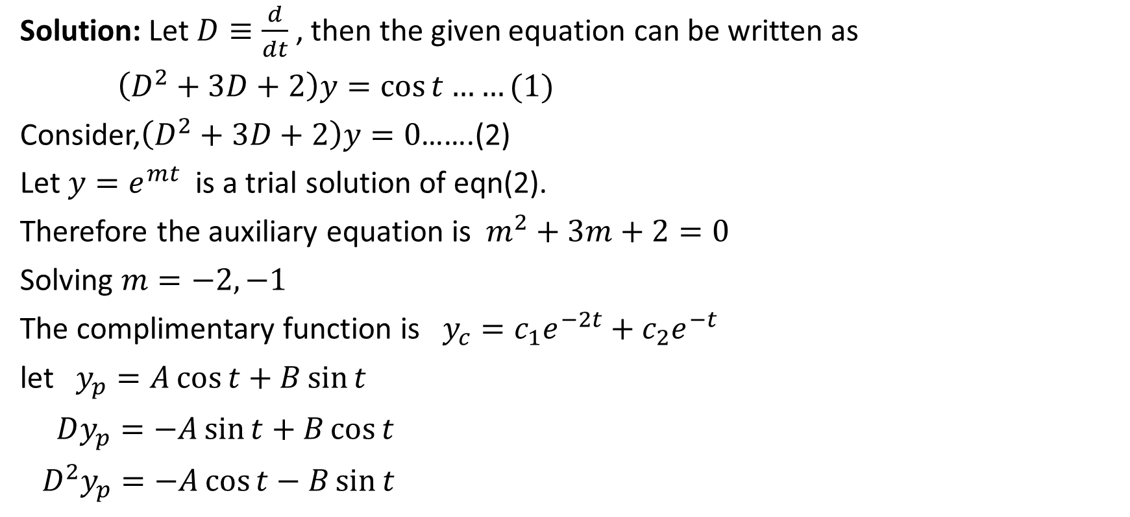
Example 7.6 Find the general solution of $\frac{d^{2}y}{dt^{2}}+3\frac{dy}{dt}+2y=\cos{t}$
Solution: Let $D≡\frac{d}{dt}$, then the given equation can be written as
$\left(D^{2}+3D+2\right)y=\cos{t}……(1)$
Consider,$\left(D^{2}+3D+2\right)y=0$…….(2)
Let $y=e^{mt}$ is a trial solution of eqn(2).
Therefore the auxiliary equation is $m^{2}+3m+2=0$
Solving $m=−2, −1$
The complimentary function is $y_{c}=c_{1}e^{−2t}+c_{2}e^{−t}$
let $y_{p}=A\cos{t}+B\sin{t}$
$Dy_{p}=−A\sin{t}+B\cos{t}$
$D^{2}y_{p}=−A\cos{t−B\sin{t}}$

Slide 17
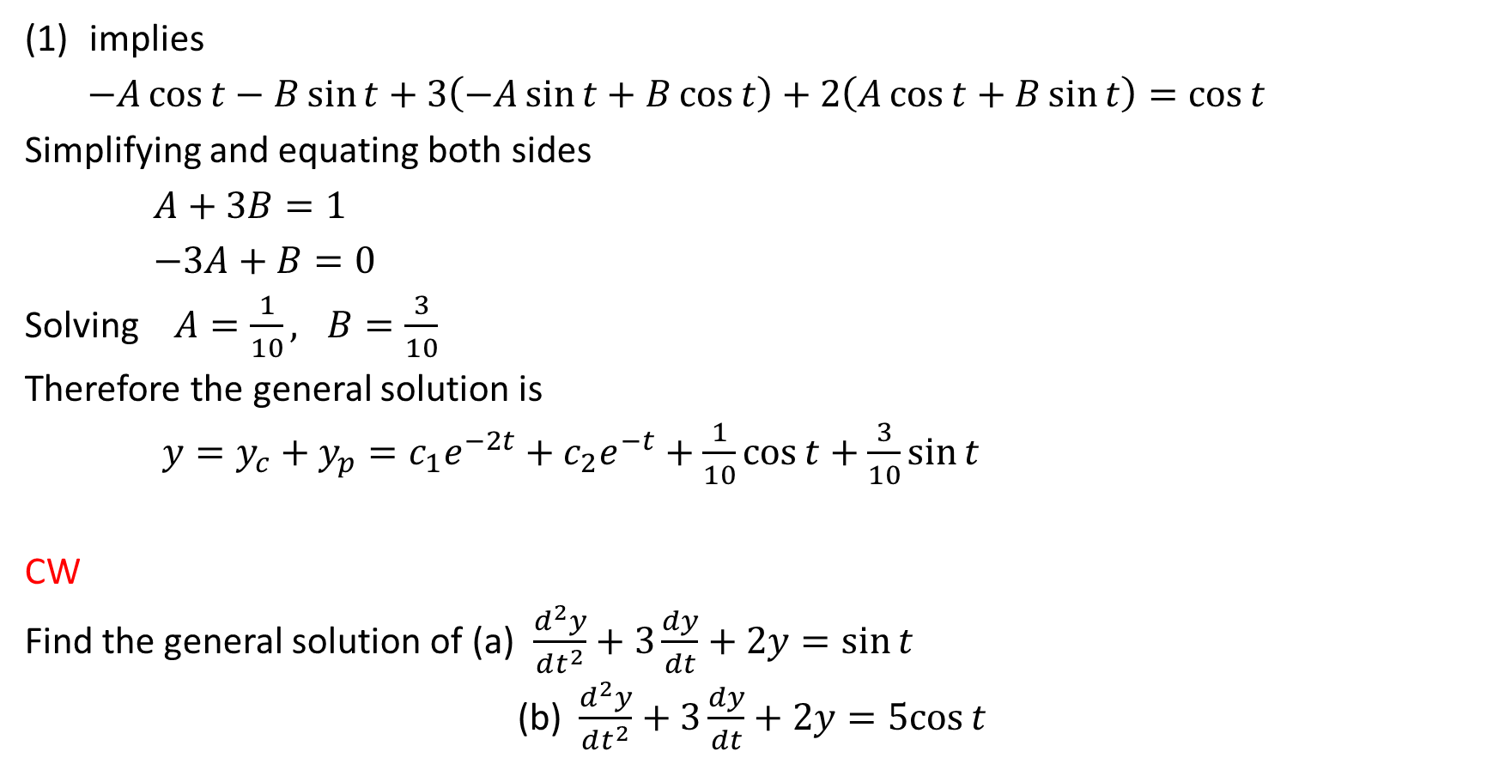
implies
$−A\cos{t−B\sin{t}}+3\left(−A\sin{t}+B\cos{t}\right)+2\left(A\cos{t}+B\sin{t}\right)=\cos{t}$
Simplifying and equating both sides
$A+3B=1$
$−3A+B=0$
Solving $A=\frac{1}{10}, B=\frac{3}{10}$
Therefore the general solution is
$y=y_{c}+y_{p}=c_{1}e^{−2t}+c_{2}e^{−t}+\frac{1}{10}\cos{t}+\frac{3}{10}\sin{t}$
CW
Find the general solution of (a) $\frac{d^{2}y}{dt^{2}}+3\frac{dy}{dt}+2y=\sin{t}$
(b) $\frac{d^{2}y}{dt^{2}}+3\frac{dy}{dt}+2y=5cos{t}$

Slide 18
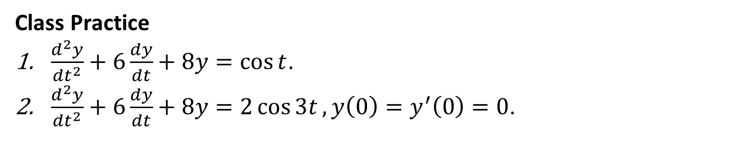
Class Practice
$\frac{d^{2}y}{dt^{2}}+6\frac{dy}{dt}+8y=\cos{t}$.
$\frac{d^{2}y}{dt^{2}}+6\frac{dy}{dt}+8y=2\cos{3t},y\left(0\right)=y^{′}\left(0\right)=0$.
Home work: P-412: 1-6, 10-12
P-424: 1-4, 9, 14
Differential Equations – P. Blanchard, R. L. Devaney, G. R. Hall (4th edition)

Slide 19
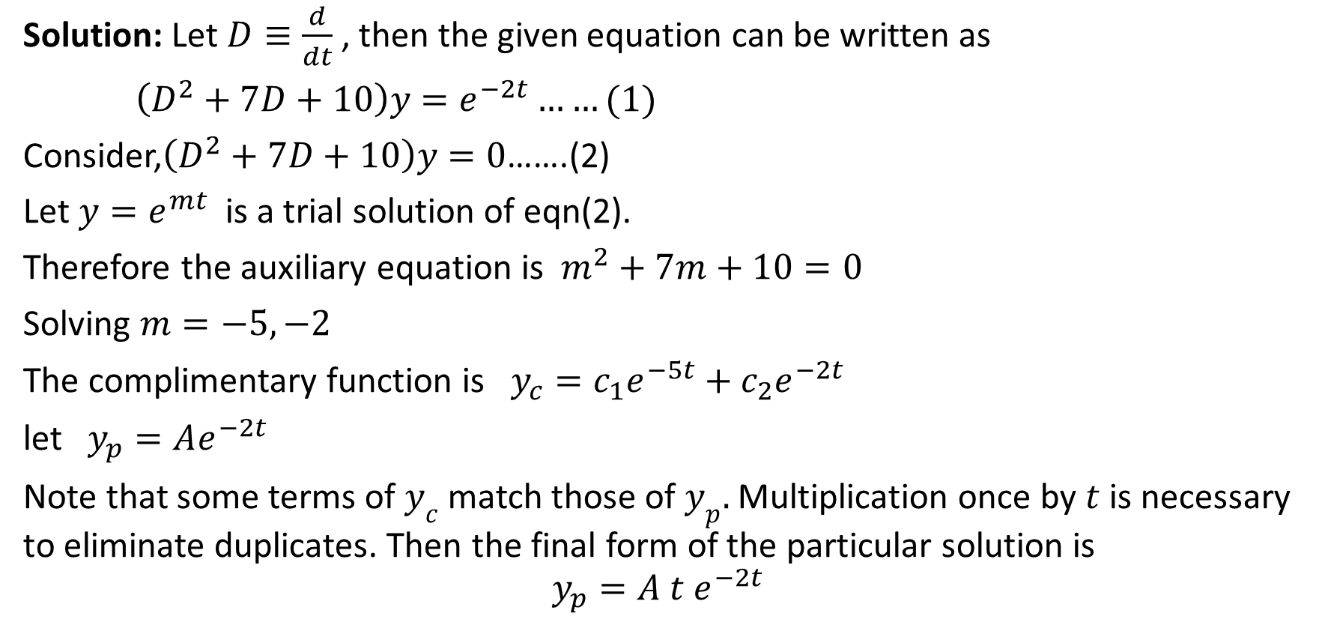
Example 7.7 Solve $\frac{d^{2}y}{dt^{2}}+7\frac{dy}{dt}+10y=e^{−2t}$
Solution: Let $D≡\frac{d}{dt}$, then the given equation can be written as
$\left(D^{2}+7D+10\right)y=e^{−2t}……(1)$
Consider,$\left(D^{2}+7D+10\right)y=0$…….(2)
Let $y=e^{mt}$ is a trial solution of eqn(2).
Therefore the auxiliary equation is $m^{2}+7m+10=0$
Solving $m=−5, −2$
The complimentary function is $y_{c}=c_{1}e^{−5t}+c_{2}e^{−2t}$
let $y_{p}=Ae^{−2t}$
Note that some terms of $y_{c}$ match those of $y_{p}.$Multiplication once by $t$ is necessary to eliminate duplicates. Then the final form of the particular solution is
$$y_{p}=A t e^{−2t}$$

Slide 20
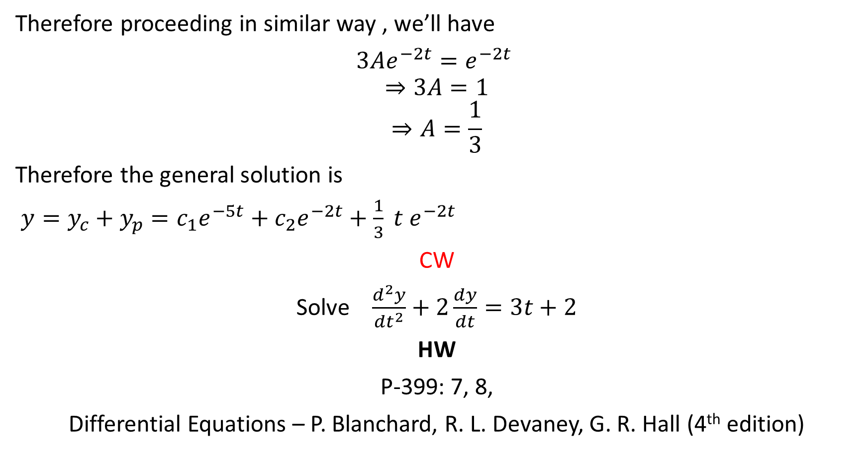
Therefore proceeding in similar way , we’ll have
$3Ae^{−2t}=e^{−2t}$
$$⇒3A=1$$
$$⇒A=\frac{1}{3}$$
Therefore the general solution is
$y=y_{c}+y_{p}=c_{1}e^{−5t}+c_{2}e^{−2t}+\frac{1}{3} t e^{−2t}$
CW
Solve $\frac{d^{2}y}{dt^{2}}+2\frac{dy}{dt}=3t+2$
HW
P-399: 7, 8,
Differential Equations – P. Blanchard, R. L. Devaney, G. R. Hall (4th edition)

Slide 21
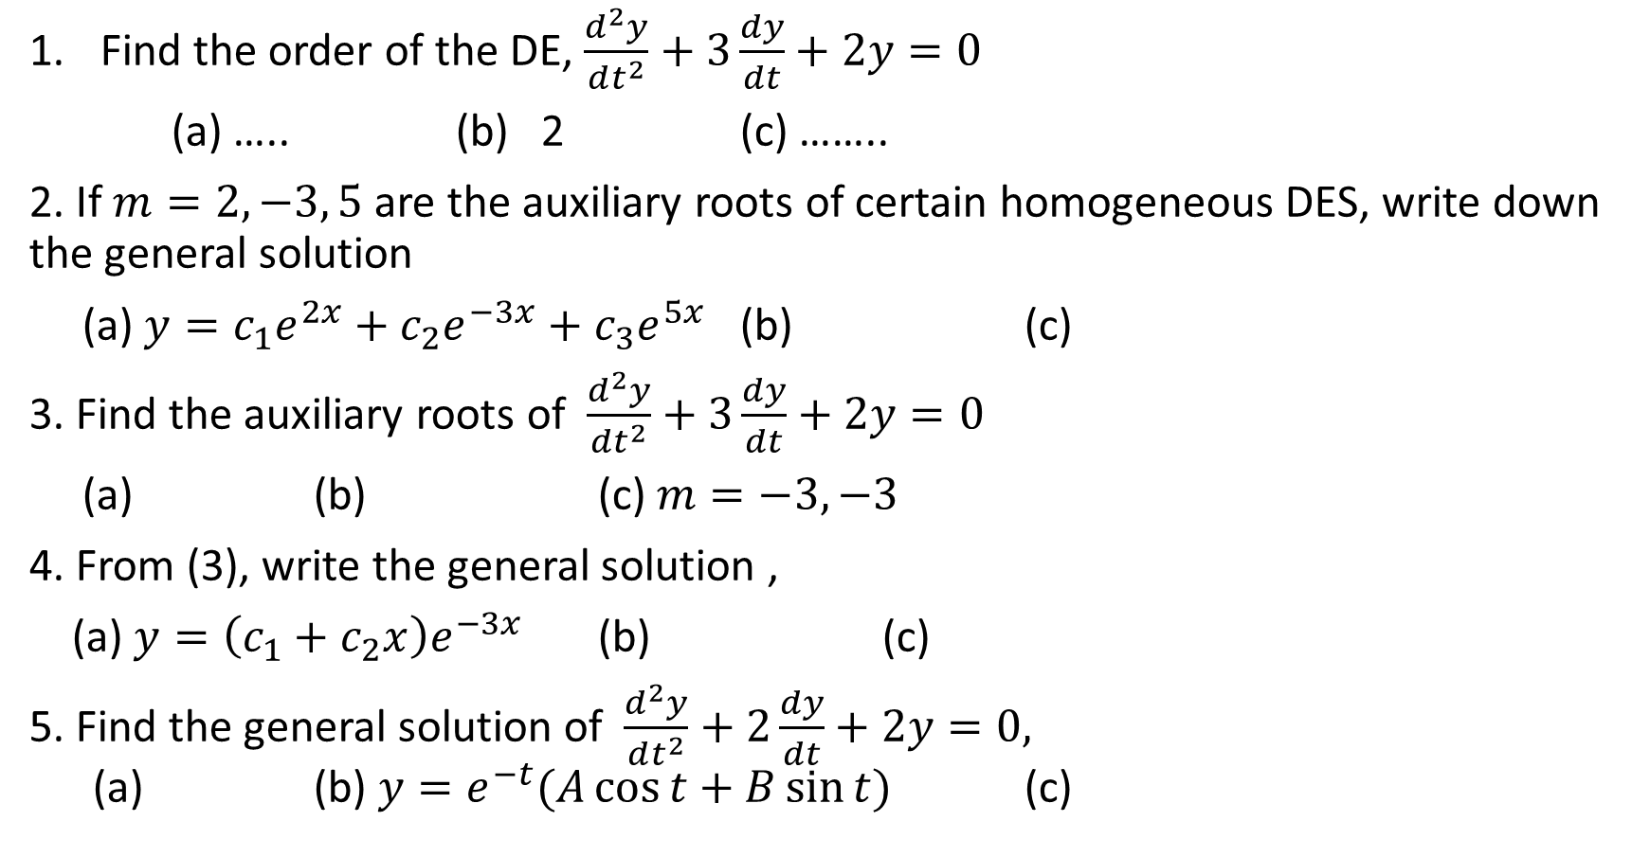
Sample MCQ
Find the order of the DE, $\frac{d^{2}y}{dt^{2}}+3\frac{dy}{dt}+2y=0$
(a) ….. (b) 2 (c) ……..
2. If $m=2, −3, 5$are the auxiliary roots of certain homogeneous DES, write down the general solution
(a) $y=c_{1}e^{2x}+c_{2}e^{−3x}+c_{3}e^{5x}$ (b) (c)
3. Find the auxiliary roots of $\frac{d^{2}y}{dt^{2}}+3\frac{dy}{dt}+2y=0$
(a) (b) (c) $m=−3,−3$
4. From (3), write the general solution ,
(a) $y=\left(c_{1}+c_{2}x\right)e^{−3x}$ (b) (c)
5. Find the general solution of $\frac{d^{2}y}{dt^{2}}+2\frac{dy}{dt}+2y=0,$ (a) (b) $y=e^{−t}(A\cos{t}+B\sin{t)}$ (c)

Slide 22
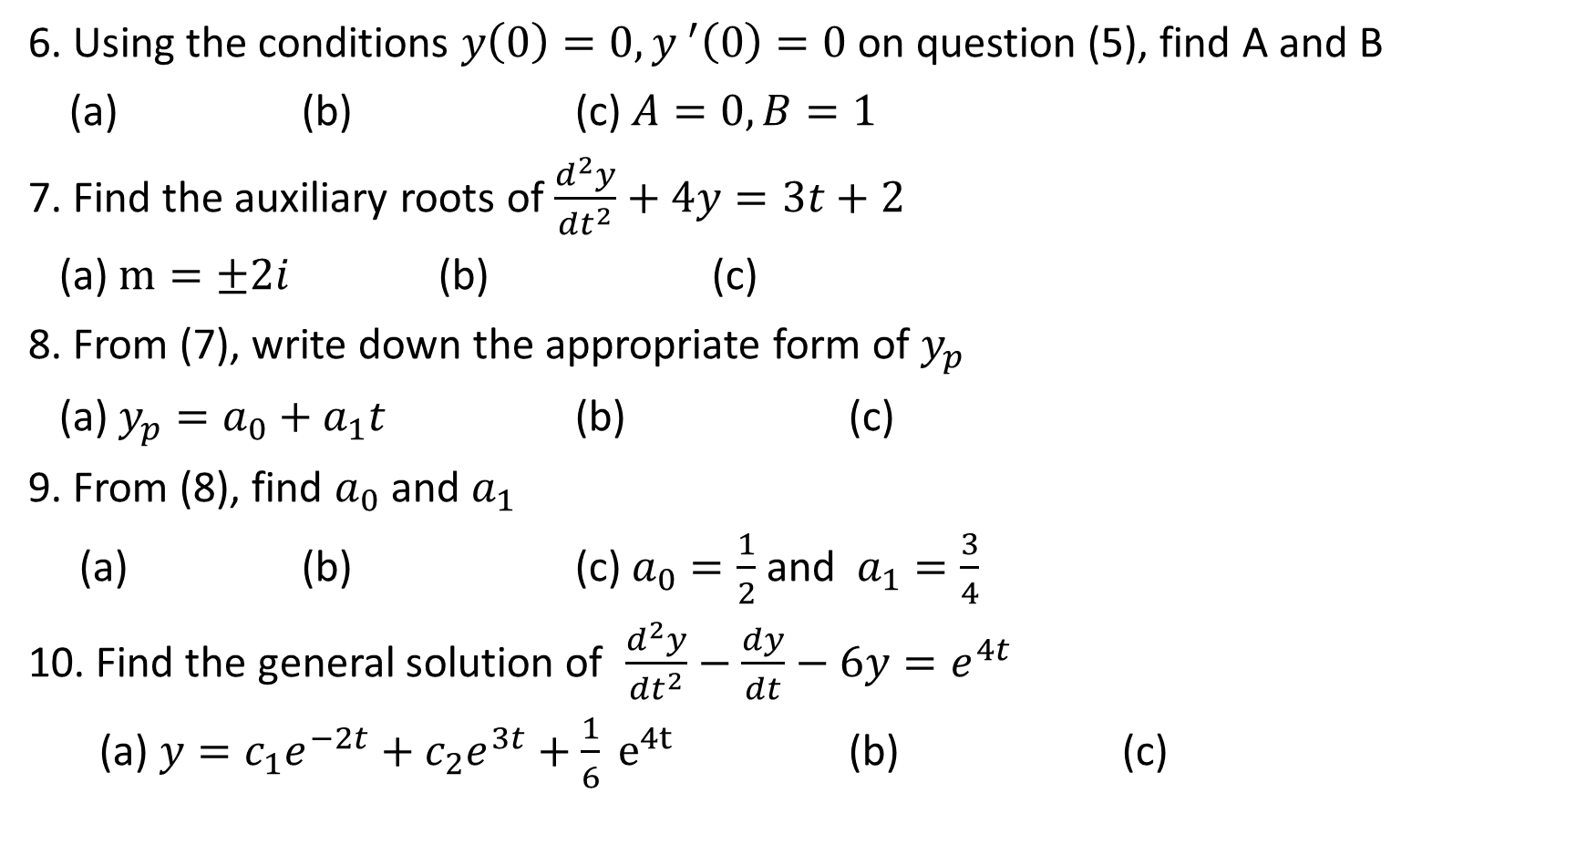
6. Using the conditions $y\left(0\right)=0, y^{ ′}\left(0\right)=0$ on question (5), find A and B
(a) (b) (c) $A=0, B=1$
7. Find the auxiliary roots of $\frac{d^{2}y}{dt^{2}}+4y=3t+2$
(a) $m=±2i$ (b) (c)
8. From (7), write down the appropriate form of $y_{p}$
(a) $y_{p}=a_{0}+a_{1}t$ (b) (c)
9. From (8), find $a_{0}$ and $a_{1}$
(a) (b) (c) $a_{0}=\frac{1}{2}$and $a_{1}=\frac{3}{4}$
10. Find the general solution of $\frac{d^{2}y}{dt^{2}}−\frac{dy}{dt}−6y=e^{4t}$
(a) $y=c_{1}e^{−2t}+c_{2}e^{3t}+\frac{1}{6} e^{4t}$ (b) (c)

Slide 23
THANK YOU

